Slide 2
Introduction
Sage CRM Key Features
Back-Office
Integration
Powerful Workflow
Management
Capabilities
Facilitates Connected,
Disconnected &
Mobile Access
Unprecedented
Ease-of-Use
Full Activity
Management
With Outlook Integration
Performance
Management with
Reports & Dashboards
Sage CRM
Key Features
360º
Customer Visibility
Easy to Configure &
Codelessly
Customisable

Slide 3
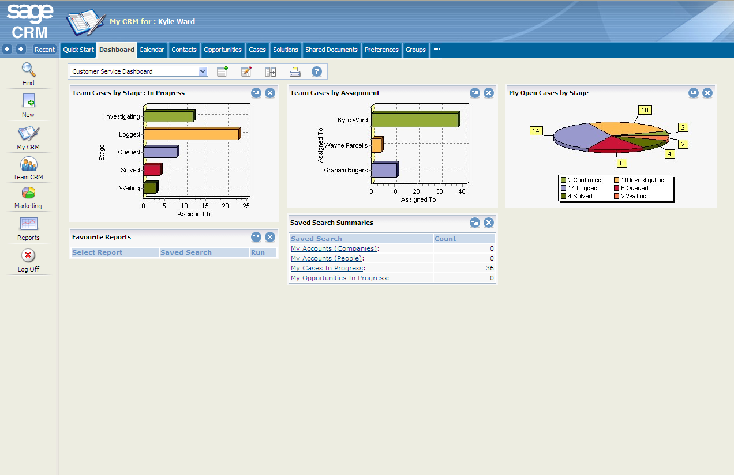
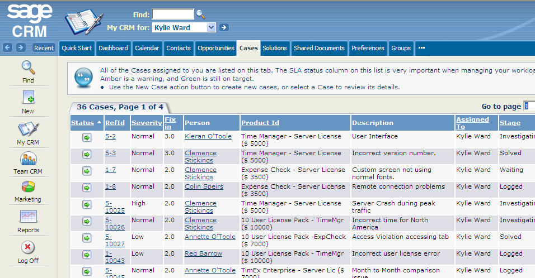
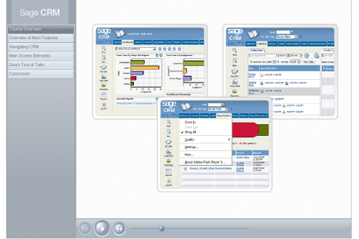
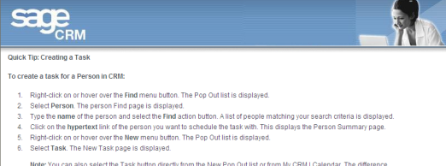
Overview
Ease-of-use
Sage CRM provides unprecedented ease-of-use
Uniquely, Sage CRM also provides a fully integrated coaching facility
Coaching captions provide explanations and instructions that are specific to the particular screen that the user is viewing
Coaching captions are also fully customisable
The Quick Start tab ensures that new users become productive on the system as soon as possible.
Users benefit from a broad range of video-based tutorials on the product
Quick Tips section provides walk through instructions on common tasks
Tab structure facilitates dynamic swapping between key information areas
Hyperlinks enable quick drill-down to underlying data
Main Menu provides access to commonly used functionality
Notes:
Additional Notes
Intuitive User Interface - Sage CRM delivers unprecedented ease-of-use by combining a highly intuitive user interface with unique tutorial and support tools that ensure a high level of user adoption from day one.
Quick Start Tab & On-Screen Coaching - The Sage CRM Quick Start tab provides employees with a selection of video-based tutorials across major areas of Sage CRM functionality while the on-screen coaching function delivers context-based assistance on specific functions and activities, which can be customised according to company-specific requirements.

Slide 4
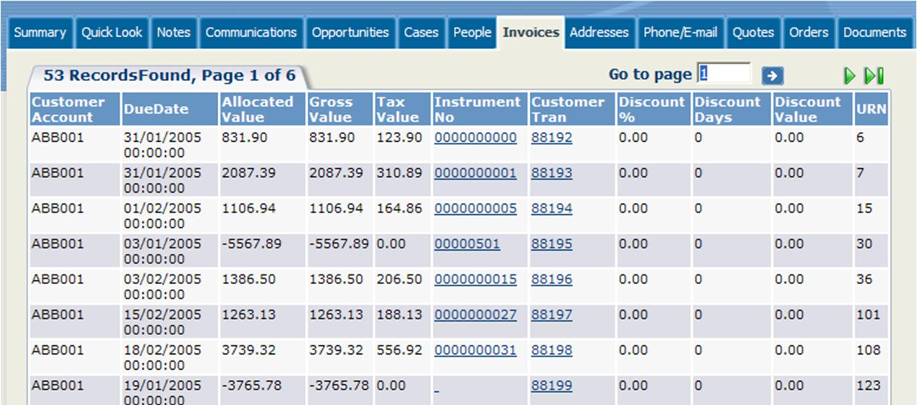
Overview
360 Degree Customer View
Sage CRM provides a 360⁰ view of customer data
Sage CRM provides real 360 degree visibility on customers across sales, marketing, customer service and accounts.
For each individual customer, users have instant access to areas such as:
Opportunities
Communications
Cases
Invoices*
Drill-down to underlying opportunity
Drill-down to underlying communication
Drill-down to underlying
case
Drill-down to underlying
Invoice*
Notes:
Additional Notes
360 Degree Customer Visibility- Sage CRM provides front-office staff with three sixty -degree visibility on their customers by bringing together sales, marketing and customer service information , and combining it with transactional data contained in your back-office system. This ensures that your staff have access to the most up-to-date, accurate and complete customer information at all times; enhancing customer service delivery, improving marketing effectiveness and facilitating the identification of cross-selling and up-selling opportunities within the customer base.
* Invoices tab provided through integration to relevant Sage ERP product and subject to regional availability.

Slide 5
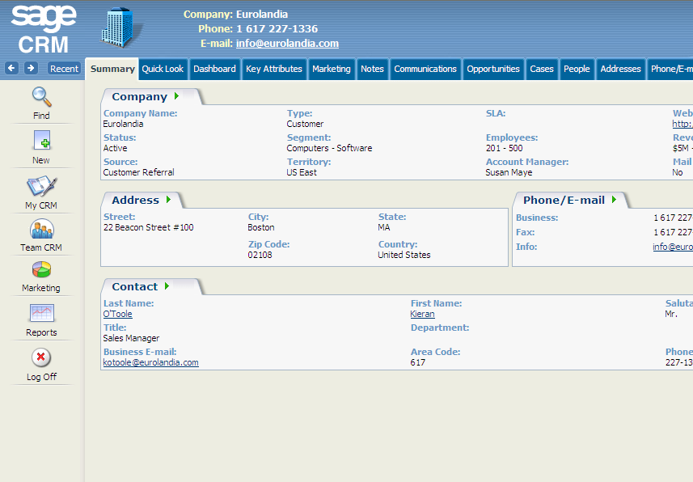
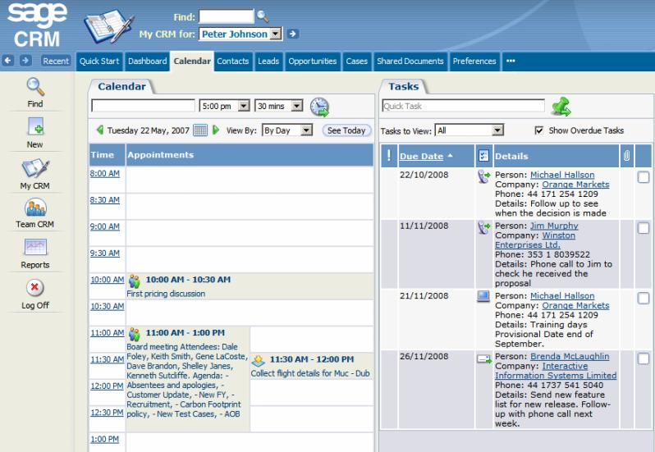
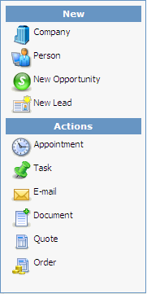
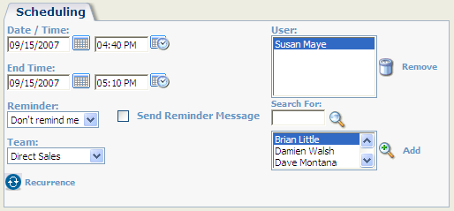
Overview
Full Activity Management
Sage CRM provides for full activity management
Sage CRM provides a complete calendar and task management solution
View by day, week, month and due-by dates
Right-click on the “New” icon in any record to setup a linked appointment or task
Schedule multi-user activities
Notes:
Additional Notes
Complete Calendar and Task Management - Sage CRM provides staff with a complete calendar and task management solution encompassing daily, weekly, monthly and due-date views. Right-clicking on the “New” icon enables user to create a new appointment or task within the contact record or opportunity that is currently on-screen.
Multi-User Collaboration - Multi-user activities can be schedules with ease and, where appropriate, users can assign, reassign or escalate activities to other users, making collaboration on multi-activity projects easy to manage.

Slide 6
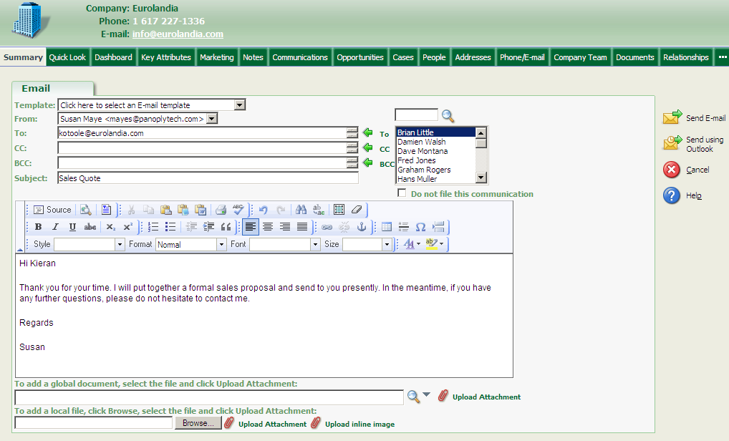
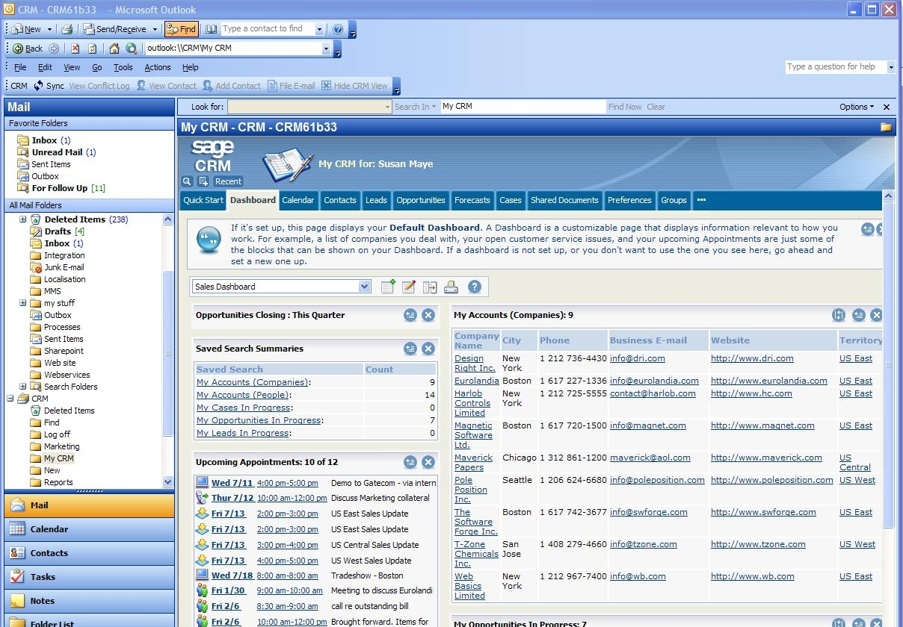
Overview
Outlook Integration
Sage CRM works seamlessly with Outlook E-mail
Sage CRM can be accessed through the Outlook interface which removes the need to switch between applications
Contacts, calendar activities and tasks are synchronised seamlessly between Outlook and Sage CRM which means data only has to be captured once in either system to be available in both
E-mails sent from Outlook can be filed against records contained within Sage CRM with one click
E-mails can be sent using Outlook from within Sage CRM using the “Send Outlook E-mail” function
Sage CRM stores and tracks attachments for both Outlook and Sage CRM e-mails
Notes:
Additional Notes
Accessed through the Outlook Interface - Sage CRM works seamlessly with Microsoft Office Outlook. Sage CRM can be accessed directly through the Microsoft Outlook interface, eliminating the need to switch between interfaces and further increasing staff adoption and productivity.
Automatic Synchronization - Emails, calendar events and contacts contained within Microsoft Outlook are automatically synchronized with Sage CRM and vice versa. Contacts, tasks and appointments only have to be entered once to be available in both systems.
Parallel Email Management - Sage CRM allows Microsoft Outlook emails to be filed against records in the Sage CRM database. Staff can also send emails from within Sage CRM using Microsoft Outlook, with any attachments automatically stored against the relevant Sage CRM contact record.

Slide 7
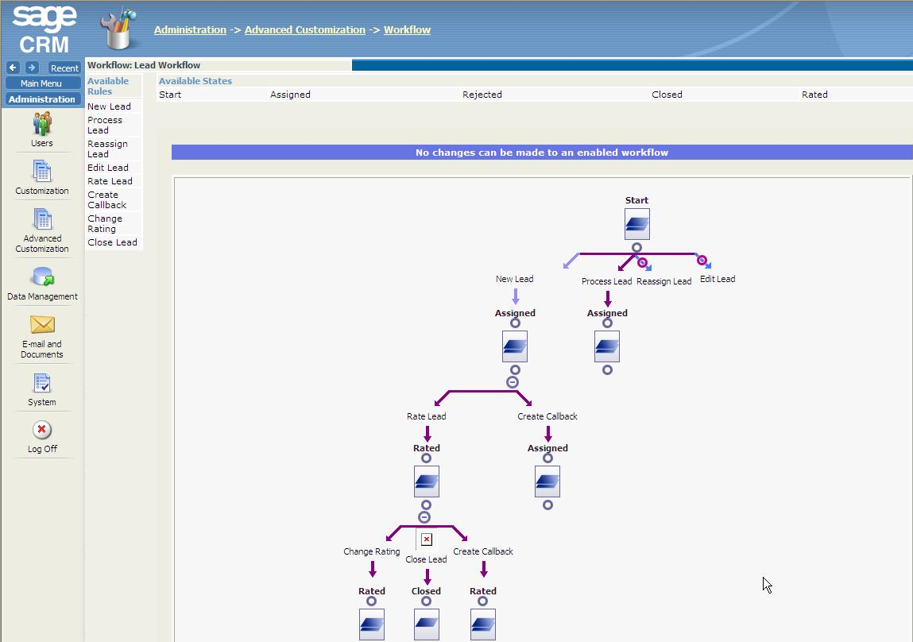
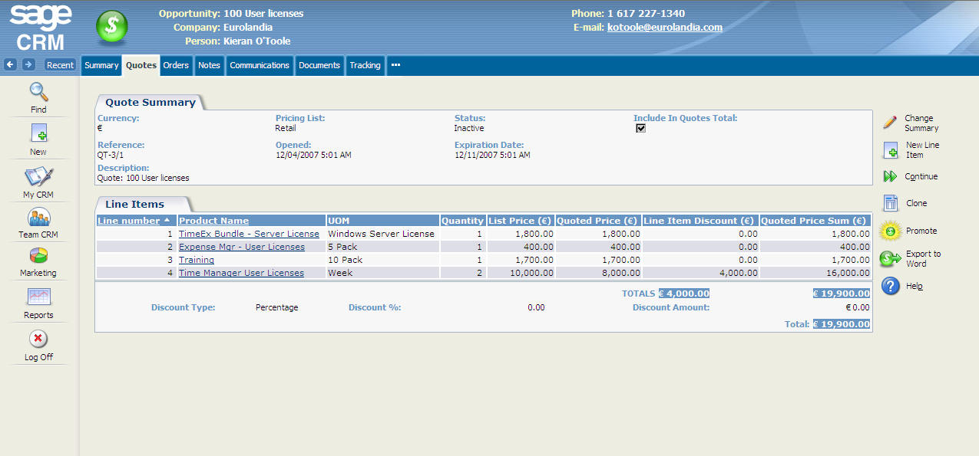
Overview
Workflow Automation
Sage CRM provides for extensive workflow automation
Sage CRM allows managers and administrators to define workflow orchestration using intuitive drag and drop tools
Workflow automation minimises administratively intensive tasks while also ensuring that activities are carried out in accordance with company processes and policies
Notes:
Additional Notes
Drag and Drop Workflow Orchestration - Sage CRM provides extensive workflow capabilities out-of-the-box. Managers can define workflow orchestration rules using intuitive, drag and drop tools. From here, alerts, escalations and task assignments are guided through pre-defined processes with a full audit trail.
Powerful Workflow Automation - With Sage CRM Workflow businesses can automate pre-determined business rules across all channels, departments and employees. In combination with e-mail integration, workflow ensures that actions requiring attention or escalation are automatically being routed to the correct employees or partners. Sage CRM creates confidence among employees that issues are not going to fall through the cracks and frees their time to perform tasks that are more important.
Notifications - Workflow notifications and alerts can be sent through a variety of means including e-mail, SMS and pop-up messages.

Slide 8
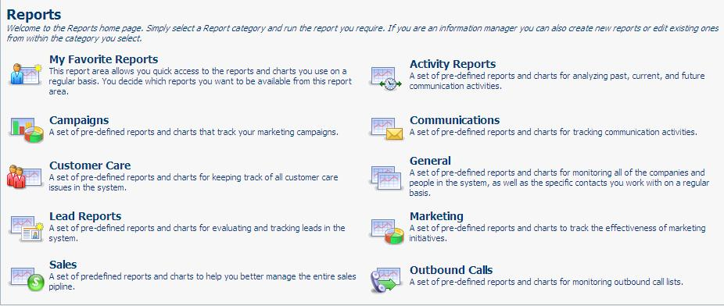
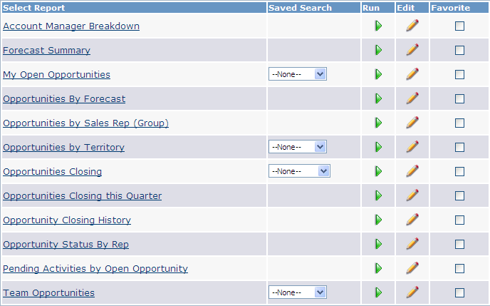
Overview
Reporting and Analytics
Sage CRM provides powerful reporting tools
Sage CRM provides a comprehensive suite of standard report categories straight out of the box
Existing reports can be fully customised and new reports can be created from scratch using Sage CRM’s wizard-based report customisation tools
Notes:
Additional Notes
Standard Reports - Sage CRM provides staff with a comprehensive suite of standard report-types straight-out-of-the-box, which can be customized according to a company’s particular requirements.
Custom Reports - Staff can create entirely new reports with ease through Sage CRM’s wizard-based reporting tools.

Slide 9
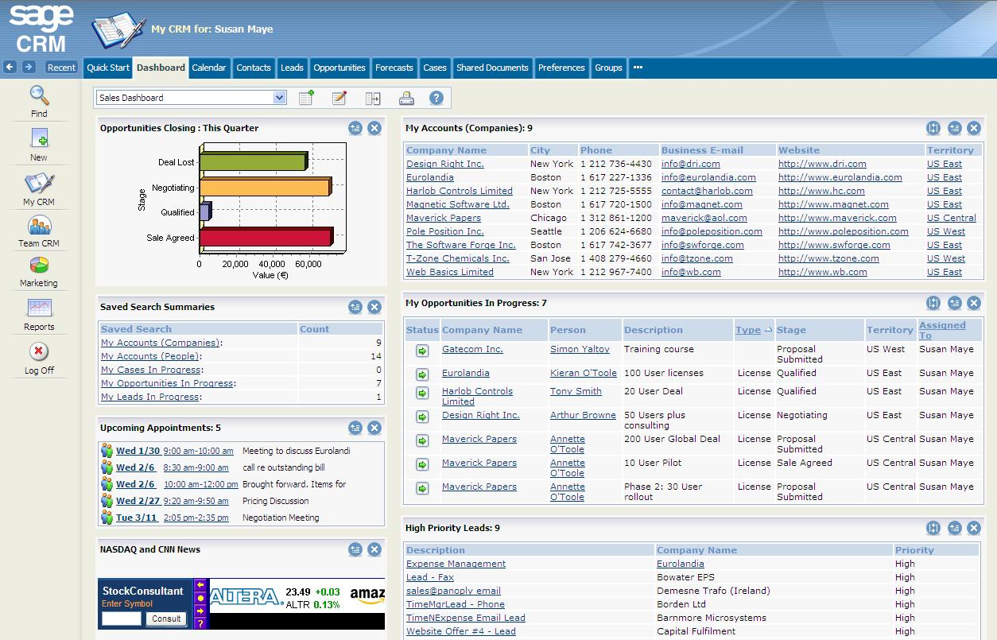
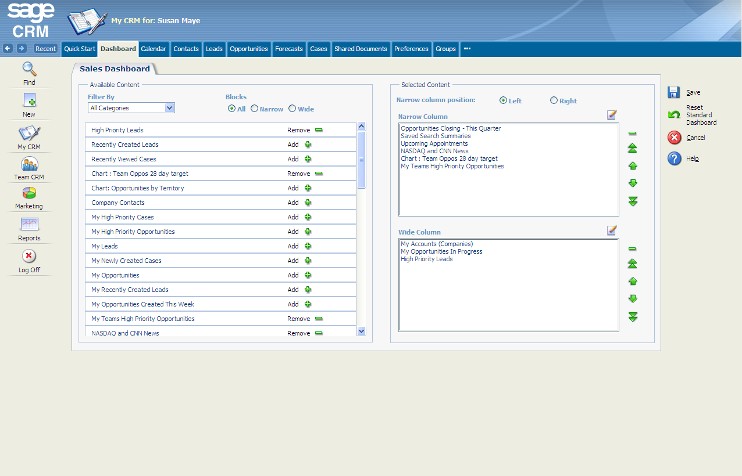
Overview
Dashboards
Sage CRM provides dashboards for all users
Sage CRM provides your staff with a range of fully configurable dashboards, which allow them to monitor key performance metrics in real-time
Dashboards can be easily customised at a user, manager and administrator level to address the particular requirements of an individual or group
Performance monitoring portlet
Saved searches portlet
Priority leads portlet
Web feed
portlet
Notes:
Additional Notes
User Dashboards - Sage CRM provides staff with a range of fully configurable dashboards, which allow them to monitor key performance metrics in real-time. Dashboards can relate to individuals, teams, departments or the entire organisation. Users can tailor their Dashboard screen to display metrics and information specific to their individual role.
Management Dashboards - Sage CRM provides management-level KPI dashboards out-of-the-box These dashboards could, for example, show a snap shot of all large opportunities scheduled to close by the end of quarter or all the leads produced from a particular marketing campaign.

Slide 10
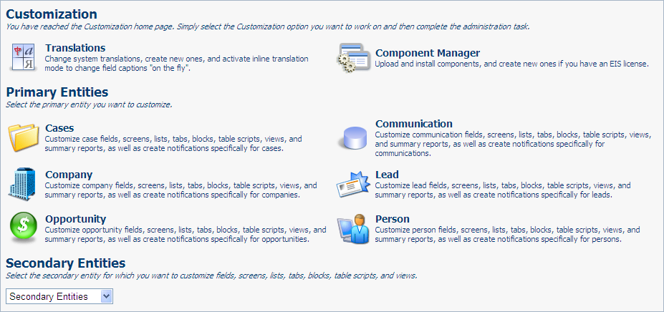
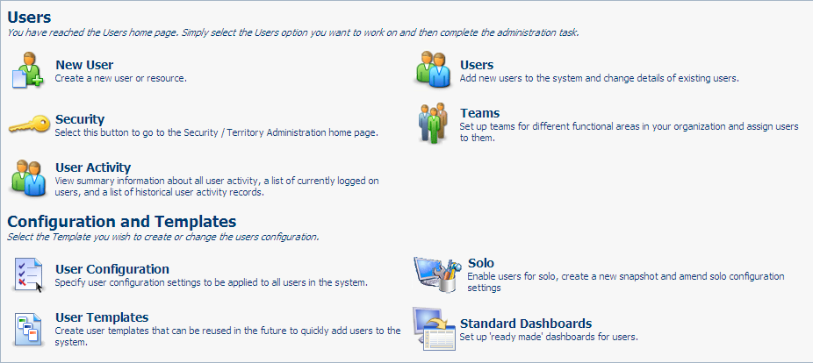
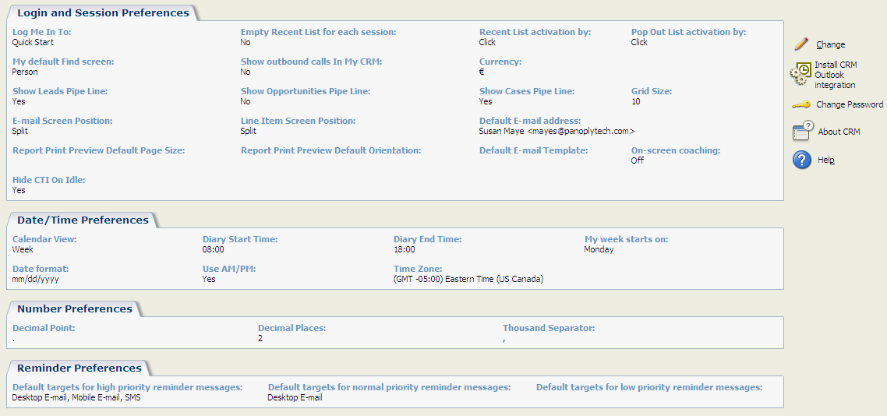
Overview
Configuration and Customisation
Sage CRM is easy to configure and customise
Individual users can configure Sage CRM in line with their individual preferences
Managers can configure Sage CRM in line with team or departmental requirements
System administrators can carry out basic and advanced customisations on a codeless basis
Notes:
Additional Notes
User-Level Configuration - Sage CRM can be configured by managers and other appropriate staff to match the particular needs of your users, while the easy-to-use customization tools allow you adapt to Sage CRM in line with changing functional requirements on a cost-efficient and flexible basis.
Codeless Customisation - Sage CRM provides for the majority of customization to be carried out on a codeless basis, removing the need for costly development resource.

Slide 11
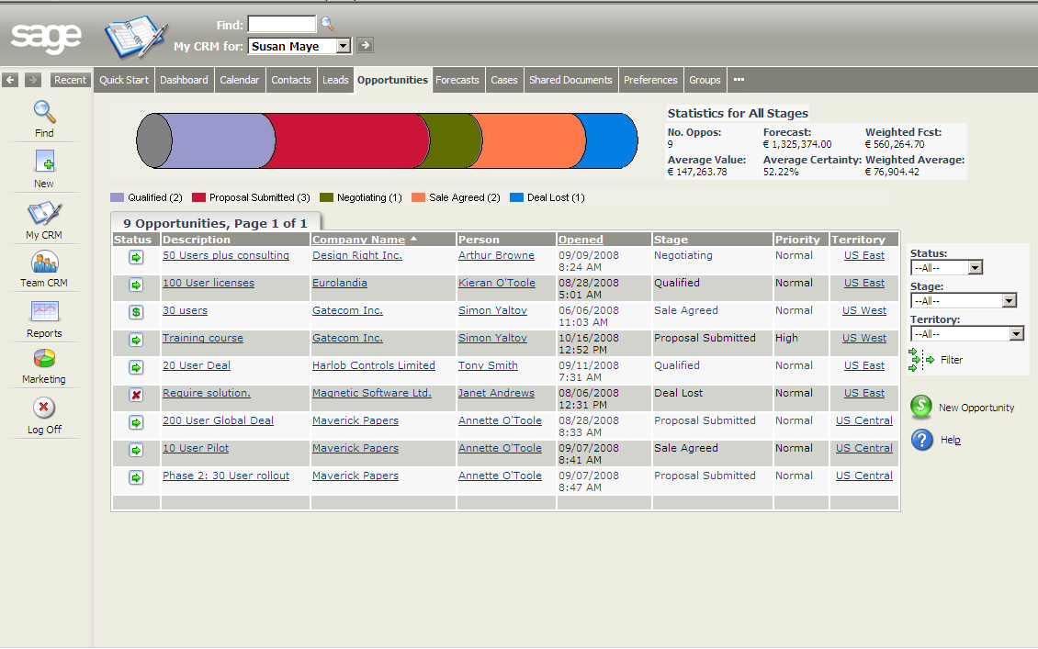
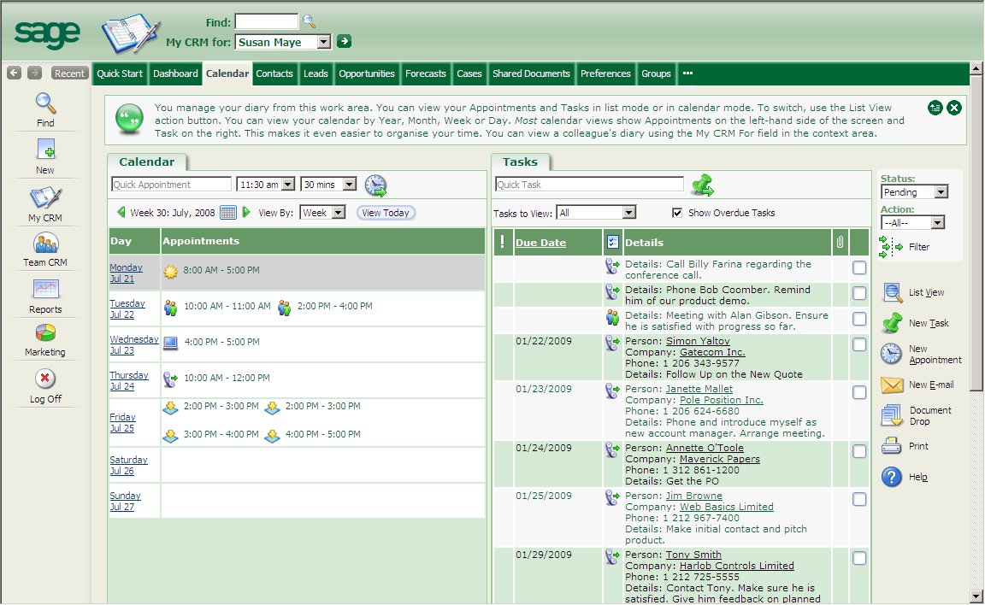
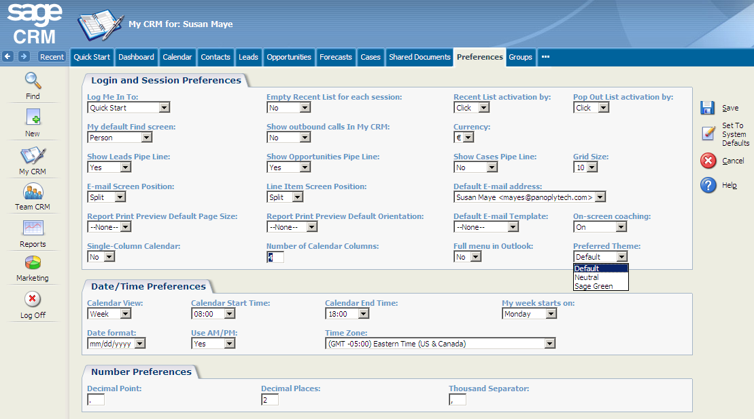
Overview
Branding Toolkit
Sage CRM user interface can be easily customised
The Sage CRM Branding Toolkit provides companies with the ability to change their user interface
Three themes are supplied out-of-the-box:
Default (Blue theme)
Sage Green
Neutral (Grey theme)
Customised themes can be created to match a company’s corporate colours
Notes:
Additional Notes
User-Level Configuration - Sage CRM can be configured by managers and other appropriate staff to match the particular needs of your users, while the easy-to-use customization tools allow you adapt to Sage CRM in line with changing functional requirements on a cost-efficient and flexible basis.
Codeless Customisation - Sage CRM provides for the majority of customization to be carried out on a codeless basis, removing the need for costly development resource.

Slide 12
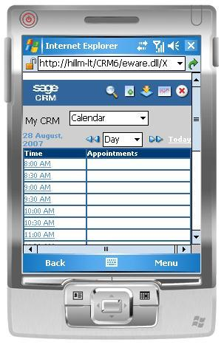
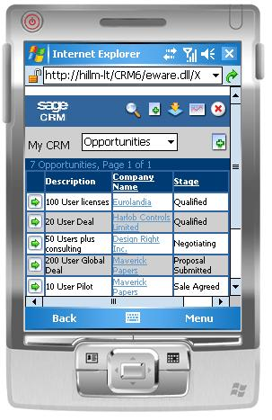
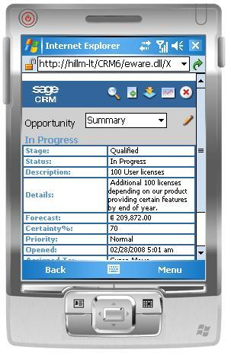
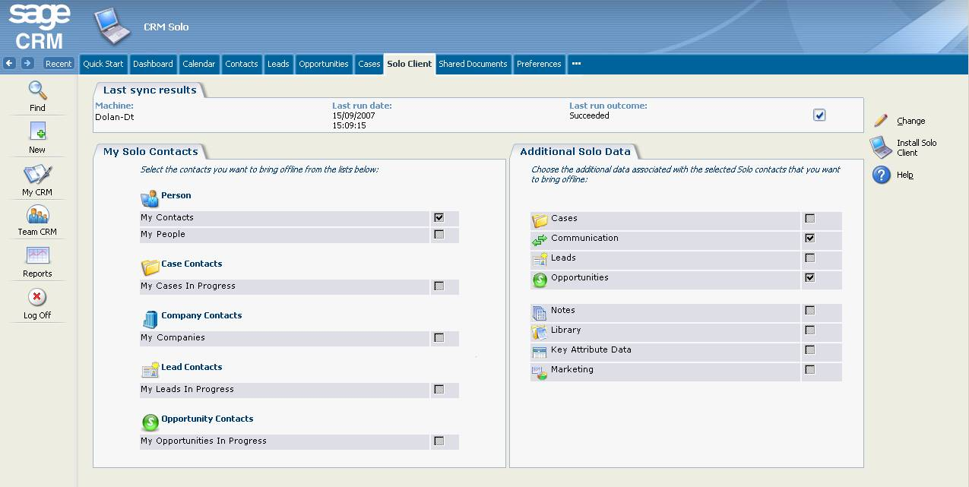
Overview
Offline Access and Mobile Access
Sage CRM provides for offline access and mobile access
Sage CRM enables users to define and download a subset of their customer data onto their laptop which can then be used on-the-road; even in the absence of an internet connection
Sage CRM can also be deployed over a variety of mobile devices providing field-based users with core Sage CRM functionality
Sage CRM can be accessed through the Outlook interface which removes the need to switch between applications
Contacts, calendar activities and tasks are synchronised seamlessly between Outlook and Sage CRM which means data only has to be captured once in either system to be available in both
Calendar view
Pipeline view
Opportunity view
Notes:
Additional Notes
Offline Client - Sales, marketing and customer service representatives need access to up-to-date, accurate customer data, regardless of their location or access scenario. The Sage CRM offline client, known as Solo, enables your field-based users to access CRM data and functionality while disconnected. Updates are synchronized with the CRM database on the next occasion when the user has online access. The Solo client can be configured quickly and easily to define the subset of customer data that will be used when disconnected. The Sage CRM offline client uses the same interface as the core Sage CRM application, simplifying access to key customer information and functionality.
Mobile Client - Sage CRM provides enhanced support for mobile devices using Microsoft Windows CE, Windows Mobile or Blackberry, allowing your field-based employees and remote-office-workers to access customer information in real-time using a standard web browser and wireless connectivity. Sage CRM is designed to take advantage of the latest wireless technologies such as GSM, EDGE, CDMA and 3G.

Slide 13
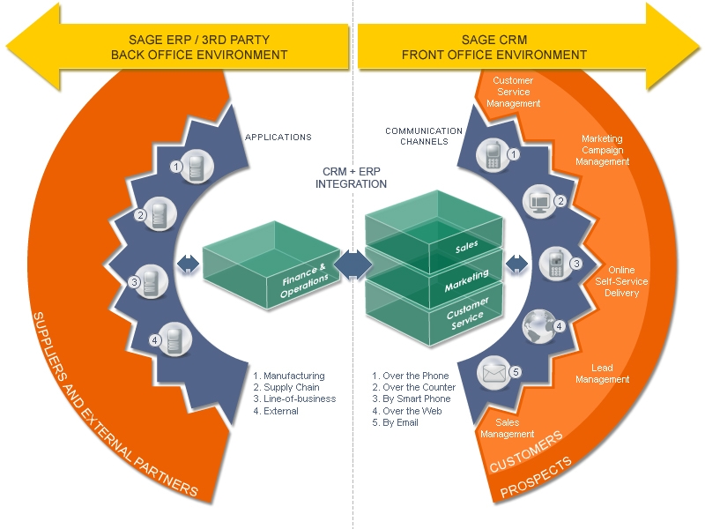
Overview
Integration with Sage Back-Office Applications
Sage CRM integrates natively with Sage ERP systems
Sage provides out-of-the-box, front-to-back-office integration with leading Sage ERP systems
This provides for:
Consistent customer data across front and back-office environments
CRM user visibility into the ERP system
“Straight-through” processes which reduce the need to re-key and re-check information during the process
Sage CRM can be accessed through the Outlook interface which removes the need to switch between applications
Contacts, calendar activities and tasks are synchronised seamlessly between Outlook and Sage CRM which means data only has to be captured once in either system to be available in both
Notes:
Additional Notes
Out-of-the-Box Integration with Sage ERP Systems - Sage CRM provides out-of-the-box integration to market-leading Sage ERP products. This equips SMBs, on a low-cost, low-complexity basis, with consistent customer data across their front and back-office environments and provides users with real customer visibility across financial and non-financial data, as well as facilitating straight-through processing which significantly reduces errors and administrative cost. Over the long-term, companies using Sage CRM’s front-to-back-office integration capabilities can expect to significantly decrease administrative cost, increase customer satisfaction and consequential revenue opportunities, and build sustainable competitive advantage in an increasingly challenging marketplace.

